Slide 1




Hadoop Cluster Installation Party
Jesse Roberts

Slide 2
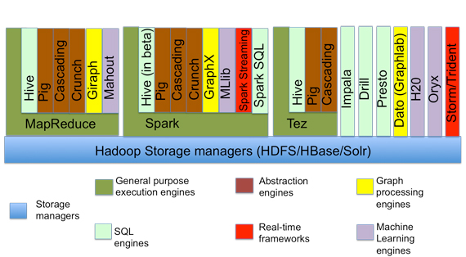
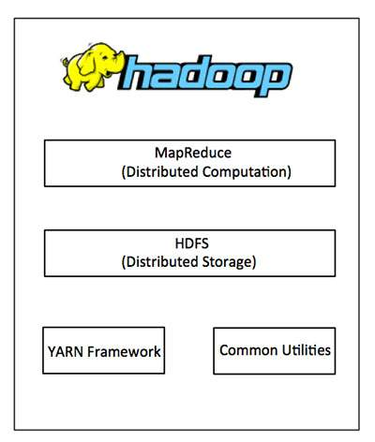
The Hadoop Framework
Extension (includes many others…..oozie, flume, etc)
At the Core
Notes:
Apache Hadoop is an open-source software framework used for distributed storage and processing of big data sets using the MapReduce programming model. It works in an environment that provides distributed storage and computation across clusters.

Slide 3
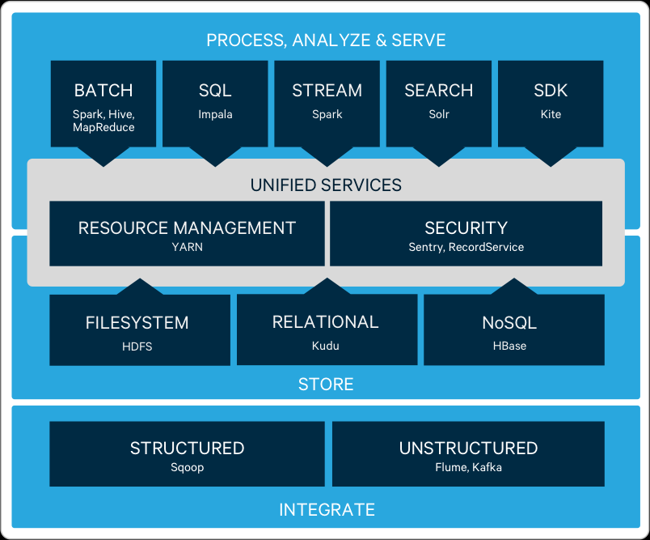
Cloudera CDH?
CDH – Cloudera Distribution including Apache Hadoop
Cloudera's open source platform
Includes other management tools like;
Cloudera Manager
Cloudera Navigator
Cloudera Reports Manager
Cloudera Activity Monitor
etc
Notes:
Different companies offer different packages or Hadoop ecosystems based on customer goals
Cloudera – CDH
Hortonworks – HDP

Slide 4
Cloudera CDH Installation
Pre-Installation
Database Installation (Extended Database)
Cloudera Manager Installation
CDH installation
CDH configuration

Slide 5
Pre-Installation (on all nodes)
->Fix Swappiness
~cat /proc/sys/vm/swappiness
~sudo sysctl -w vm.swappiness=1
~cat /proc/sys/vm/swappiness
~sudo vi /etc/sysctl.conf
#add this line (vm.swappiness=1)
->Disable firewall and selinux
~sudo /etc/init.d/iptables stop
~sudo chkconfig iptables off
~sudo chkconfig ip6tables off
~sudo vi /etc/selinux/config
#change "enforcing" to "permissive" or "disabled"
->Disable transparent hugepage support
~sudo vi /etc/grub.conf
#add "transparent_hugepage=never" to the kernel
~sudo reboot
#check that it worked
~cat /sys/kernel/mm/transparent_hugepage/enabled
(always madvise [never])
->Set ulimits for common users
~sudo vi /etc/security/limits.d/90-nproc.conf
#change the value 1024 on category (*) to 4096
#logout and login
#check to see that the limit has been set
~ulimit -u (should respond with 4096)
~ulimit -n (should respond with 1024)

Slide 6
Pre-Installation (on all nodes) - cont
->Activate ntpd
~sudo yum install -y ntp
~sudo chkconfig ntpd on
~sudo service ntpd start
~sudo service ntpd status
->Install nscd (to cache dns entries)
~sudo yum install -y nscd
~sudo service nscd start
~sudo chkconfig nscd on

Slide 7
Cloudera Installation notes
Three methods/ procedures;
One-stop binary installer
short-term, throwaway projects with embedded, hard-configured Postgre-Sql server
Install Cloudera Manager (CM) and databases manually
Clusters meant to run for 3-6 months, support oracle, mysql and postgre and can deploy CDH with linux packages or parcels)
Tarballs
Useful if privileged access is not available and you don't need cloudera manager
**This workshop will focus on method B, Which is quite useful for production environments

Slide 8
Database Installation - MySQL
#on all nodes, download mysql rpm package
~wget https://dev.mysql.com/get/Downloads/MySQL-server-5.5.55-1.el6.x86_64.rpm
~sudo rpm -Uvh MySQL-server-5.5.55-1.el6.x86_64.rpm
~sudo yum -y update
#download the mysql jdbc connector
~wget https://dev.mysql.com/get/Downloads/Connector-J/mysql-connector-java-5.1.42.tar.gz
~tar zxvf mysql-connector-java-5.1.42.tar.gz
~sudo mkdir -p /usr/share/java
~sudo cp mysql-connector-java-5.1.42/mysql-connector-java-5.1.42-bin.jar /usr/share/java/mysql-connector-java.jar

Slide 9
Database Installation – MySQL (cont.)
#on the server and possible replica nodes
~sudo yum install -y mysql-server (1 replica node)
#start the mysql server
~sudo service mysqld start
~sudo /usr/bin/mysql_secure_installation
current password: (just press "Enter" for fresh installations)
set Root Pasword: Y
enter new pass: *******
reenter new pass: ******
remove anonymous users?: Y
disallow root login remotely?: N
remove test database?: Y
reload privilege tables?: Y
~sudo service mysqld restart

Slide 10
Database Replication – MySQL (cont.)
#On the master MySQL node, grant replication privileges for your replica node:
~sudo vi /etc/my.cnf
[mysqld]
log-bin=mysql-bin
server-id=1
transaction-isolation = READ-COMMITTED
innodb_flush_method = O_DIRECT
binlog_format = mixed
~sudo service mysqld restart
# Log in to mysql
~mysql -u root -p
# Note the FQDN of your replica host.
~mysql> GRANT REPLICATION SLAVE ON *.* TO 'user'@'FQDN' IDENTIFIED BY 'password';
~mysql> SET GLOBAL binlog_format = 'ROW';
~mysql> FLUSH TABLES WITH READ LOCK;

Slide 11
Database Replication – MySQL (cont.)
#In a second terminal session, log into the MySQL master and show its status:
~mysql> SHOW MASTER STATUS;
#Capture the file name and byte offset. The replica uses this info to sync to the master.
#Logout and dismiss the second session;
#on the first session
#remove the lock on the first with
~mysql> UNLOCK TABLES;
#Now log on to the replica.
~sudo vi /etc/my.cnf
[mysqld]
server-id=2
~sudo service mysqld restart

Slide 12
Database Replication – MySQL (cont.)
#Use the following statements to connect with the master:
~mysql> CHANGE MASTER TO MASTER_HOST='master host', MASTER_USER='replica user', MASTER_PASSWORD='replica password', MASTER_LOG_FILE='master file name', MASTER_LOG_POS=master file offset;
#Now start slave
~mysql> START SLAVE;
~mysql> SHOW SLAVE STATUS \G
#If successful, the Slave_IO_State field will read Waiting for master to send event

Slide 13
Database Creation – MySQL (cont.)
#On the Master MySQL server, login and create databases for the services
~mysql -u root -p
#create databases for the SCM (scm), Activity Monitor (amon), Reports Manager (rman), Hive Metastore Server (hive), Hue Server (hue), Sentry Server (sentry), Cloudera Navigator Audit Server (nav), Cloudera Navigator Metadata Server (navms) and Oozie (oozie)
~create database amon DEFAULT CHARACTER SET utf8;
~grant all on amon.* TO 'amon'@'%' IDENTIFIED BY 'amon_password';
amon, rman, hive, hue, sentry, nav, navms

Slide 14
Cloudera Manager Installation
#on the server, Install the Cloudera Manager
#first download the version suiting your OS
~wget https://archive.cloudera.com/cm5/redhat/6/x86_64/cm/cloudera-manager.repo
~sudo cp cloudera-manager.repo /etc/yum.repos.d/
#install JDK
~sudo yum install -y oracle-j2sdk1.7
#Install cloudera-manager server packages
~sudo yum install -y cloudera-manager-daemons cloudera-manager-server
#prepare database for cloudera manager
~sudo /usr/share/cmf/schema/scm_prepare_database.sh 'database-type' 'database_name' 'user' 'user_password'
e.g.(sudo /usr/share/cmf/schema/scm_prepare_database.sh mysql scm scm scm_password)
#optional (add the -h option to specify host if the database server is situated on a server different from the cloudera server) e.g. -h cm-oracle.example.com

Slide 15
CDH Installation & Configuration
#Start cloudera manager
~sudo service cloudera-scm-server start
#login on a browser using the public ip and the default port 7180
default credentials are username:admin, password, admin
choose cdh parcels, use pem file to login and don't select single use mode
copy the Master's internal address and paste in /etc/cloudera-scm-agent/config.ini
before pushing parcels
#Push the parcels to the agents (u can tail the master node to see what's going on in the field) - var'log/cloudera-scm/cloudera-scm-log
#all the services should be having good health (green sign)
#check hosts heartbeats

Slide 16
A MapReduce Example
Log into a host in the cluster.
Run the Hadoop PiEstimator example using one of the following commands:
#Parcel
~sudo -u hdfs hadoop jar /opt/cloudera/parcels/CDH/lib/hadoop-mapreduce/hadoop-mapreduce-examples.jar pi 10 100
#Package
~sudo -u hdfs hadoop jar /usr/lib/hadoop-mapreduce/hadoop-mapreduce-examples.jar pi 10 100

Slide 17
Additional Information
Contact: studentpartners@ultratendency.com
Facebook: https://www.facebook.com/ultratendency/
Your opinion is important : https://www.survio.com/survey/d/N7G7M1R7P7C9D9Z5Z
THANK YOU FOR YOUR ATTENTION

